Slide 1



WAVECON TELECOM ANALYSIS
5G IMPACT ON WAVECON REVENUE
Presented By –Sayan Bhattacharjee

Slide 2
Table of Content
Introduction
What is the impact of the 5G launch on our revenue?
Which KPI is underperforming after the 5G launch?
After the 5G launch, which plans are performing well in terms of revenue? Which plans are not performing well?
Is there any plan affected largely by the 5G launch? Should we continue or discontinue that plan?
Is there any plan that is discontinued after the 5G launch? What is the reason for it?
Recommendations

Slide 3

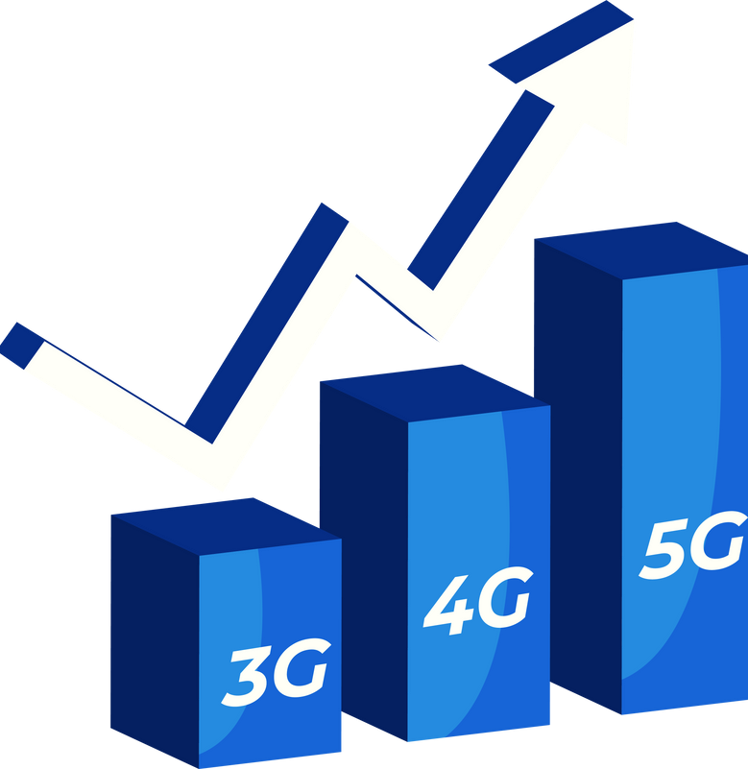
INTRODUCTION
Wavecon, a leading telecom provider in India, launched its 5G services in May 2022 across major cities to meet growing data demands, enhance user experience, and drive technological advancements in the telecom sector.
The objective of this analysis is to evaluate the impact of the 5g launch on wavecon’s performance in revenue, and aims to identify underperforming areas, understand trends across different metrics, and highlight reasons behind performance shifts. this will help stakeholders make informed decisions to optimize strategies, address challenges, and drive growth post-5g implementation.

Slide 4
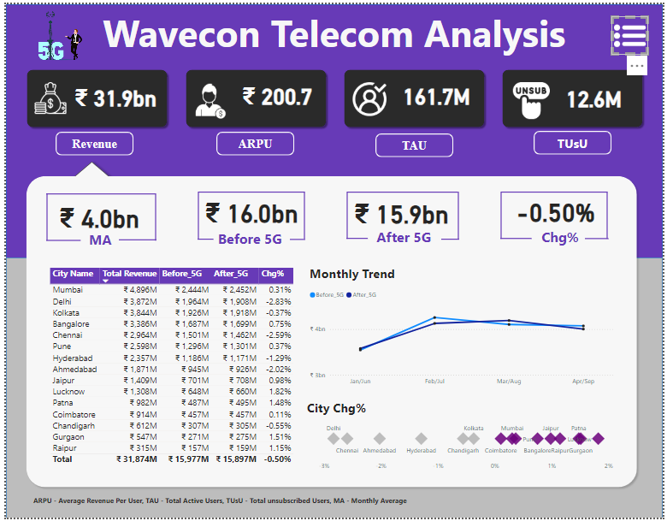
DASHBOARD

Slide 5
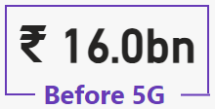
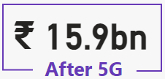
1. What is the impact of the 5G launch on our revenue?
The 5G launch has resulted in a slight decrease in total revenue, dropping by ₹0.1 billion. This minimal decline indicates a transitional phase where older plans are being phased out while new 5G plans are still being adopted by customers. The shift in consumer preferences and the adjustment period for 5G plans may have contributed to this small reduction.

Slide 6



2. Which KPI is underperforming after the 5G launch?
Total Revenue Before 5G: ₹16.0bn After 5G: ₹15.9bn
Total Revenue
Change: A slight decrease of -0.50%.
Despite the introduction of 5G, the total revenue has seen a minor decline. This drop indicates that while 5G plans were launched, they did not significantly boost revenue, likely due to users not upgrading or opting for cheaper alternatives
Before 5G : 84.4M, After 5G : 77.4M
The number of active users remains stable but shows no significant growth after the 5G rollout. This suggests that the 5G launch did not attract a notable increase in user engagement or new subscriptions
Active Users
Total Unsubcribed Users
Before 5G : 5.6M, After 5G : 7M
User dissatisfaction or a lack of perceived value in the 5G plans.

Slide 7
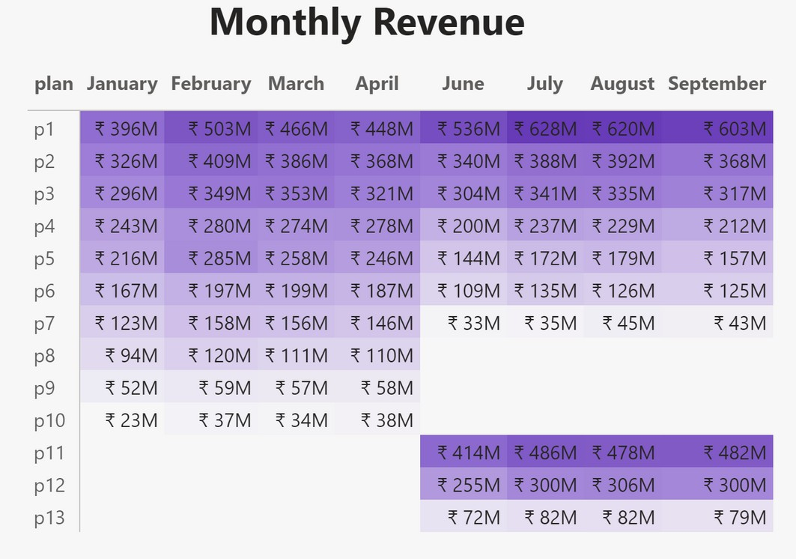





3. After the 5G launch, which plans are performing well in terms of revenue? Which plans are not performing well?
Good performing plans
After the 5G launch, plans 1, 2, and 3 are performing well in terms of revenue
Bad performing plans
After the 5G launch, plans 5, 6, and 7 are not performing well in terms of revenue

Slide 8
4. Is there any plan affected largely by the 5G launch? Should we continue or discontinue that plan?
Impact of 5G Launch on Existing Plans:
Positive Impact
Plan 1 - Smart Recharge Pack
Plan 11 - Ultra Fast Mega Pack
Plan 12 - Ultra Duo Data Pack
Details: 2GB/Day Combo for 3 Months
Revenue Before Launch: ₹1.8 Billion
Revenue After Launch: ₹2.4 Billion
Details: 3GB per day combo valid for 80 days.
Current Revenue: ₹1.9 Billion
Details: 1.8GB per day combo valid for 55 days.
Current Revenue: ₹1.2 Billion
Reason for Strong Performance: Affordable pricing combined with a high data limit made this plan attractive to users upgrading to 5G.
Reason for Strong Performance: The plan offered significant data capacity, catering to heavy data users benefiting from 5G’s faster speeds.
Reason for Strong Performance: Its balanced price-to-data offering appealed to a wide range of customers transitioning to 5G, ensuring steady adoption.
Negative Impact
Plan 7 - 25GB Combo (3G/4G Data Pack)
Revenue Before 5G Launch: ₹582.4 Million
Revenue After 5G Launch: ₹155.6 Million
Reason for Poor Performance: Outdated 3G/4G offering became less appealing as users shifted to faster 5G plans.

Slide 9
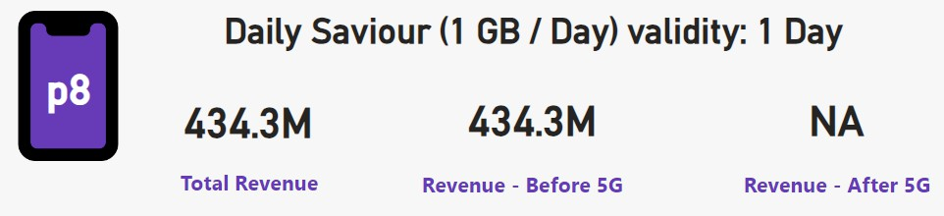
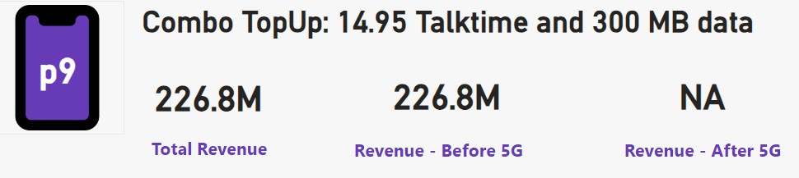
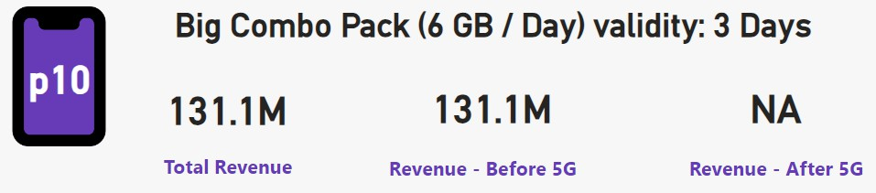
5. Is there any plan that is discontinued after the 5G launch? What is the reason for it?
P8 - Daily Saviour (1 GB / Day, 1 Day Validity)
Reason for Discontinuation: Limited 1-day validity and low data offering became unattractive with the availability of affordable, higher-capacity 5G plans.
P9 - Combo TopUp (14.95 Talktime + 300 MB Data) Reason for Discontinuation: Insufficient data (300 MB) and outdated top-up format did not meet modern user demands, especially with the shift to data-heavy 5G usage.
P10 - Big Combo Pack (6 GB / Day, 3 Days Validity) Reason for Discontinuation: Short validity period and better alternatives with extended validity and higher data limits under new 5G plans led to a decline in demand.

Slide 10
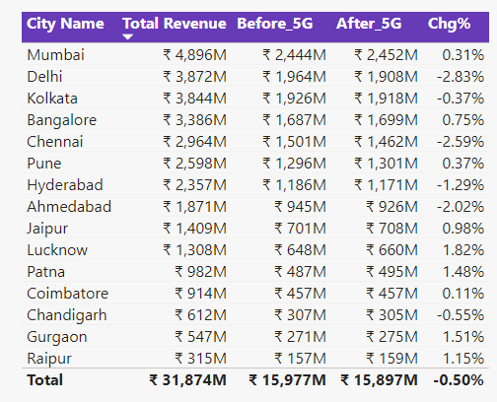
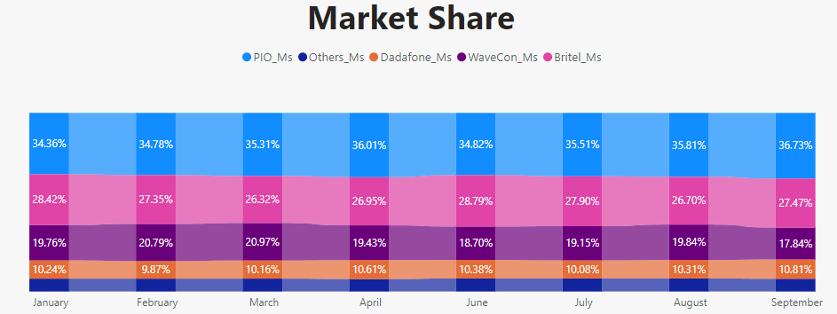
Additional Insights
Key Insights:
The market share peaked at 20.97% in March but has
since declined, reaching 17.84% in September, reflecting a downward trend.
Competitors such as PIO and Britel appear to hold more stable or increasing shares, indicating a potential loss of market competitiveness for WaveCon.
Underperforming KPI After the 5G Launch
The Churn Rate Percentage (Chg%) is underperforming after the 5G launch, showing a -0.50% decline.
Additionally, cities like Delhi (-2.83%), Chennai (-2.59%), and Ahmedabad (-2.02%) reported significant revenue drops, contributing to the overall underperformance.
This indicates customer attrition and challenges in retaining subscribers post-5G rollout.

Slide 11
RECOMMENDATIONS
Flexible Plans: Introduce customizable plans where users can select validity, data, and benefits as per their needs.
Focus on Value-Added Features: Add features like OTT bundles, gaming perks, or 5G speed boosters to differentiate from competitors.
Affordable 5G Data Plans: Develop affordable, high-capacity 5G plans to cater to
growing data usage trends while maintaining profitability.
Customer Insights: Conduct regular surveys to identify evolving preferences and pain points, ensuring plans remain relevant and attractive.

Slide 12
THANK YOU

